Slide 1

Hasło AZURE

Slide 2




[WRO] 10 spotkanie Microsoft Azure User Group Poland we Wrocławiu
Piotr Rogala
Partnerzy

Slide 3
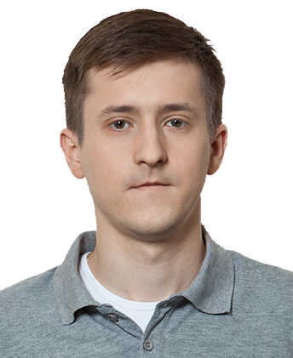

About Me
Current working in UNIT4
MVP Azure
Blog: justcloud.pl
FB Page: facebook.com/justcloudpl
Group leader:
Microsoft Azure User Group Poland

Slide 4

Sponsor spotkania:
web: https://unit4.com

Slide 5

Kolejny meetup
11 Wrzesień 2018

Slide 6

Microsoft Azure User Group Poland
Meetup:
http://www.meetup.com/Microsoft-Azure-Users-Group-Poland/events
Facebook:
https://www.facebook.com/groups/azureugpl
Web
http://azureug.org

Slide 7

CloudPoland
Zaproszenie do kanału:
https://cloudpoland.azurewebsites.net
http://slack.justcloud.pl

Slide 8
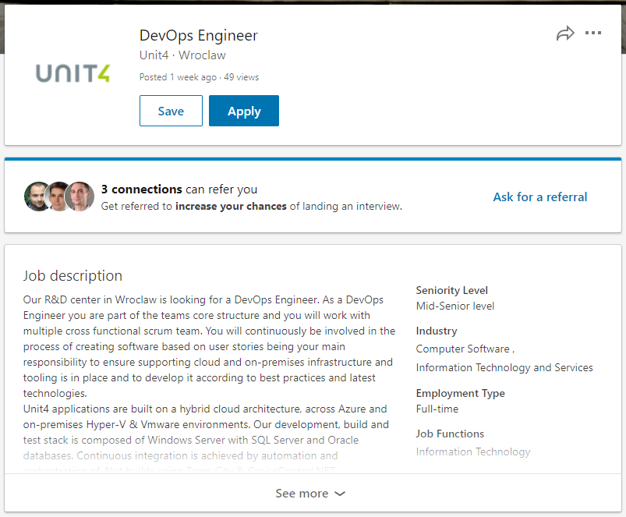
UNIT4 HR
piotr@justcloud.pl
LinkedIN
UNIT4

Slide 9
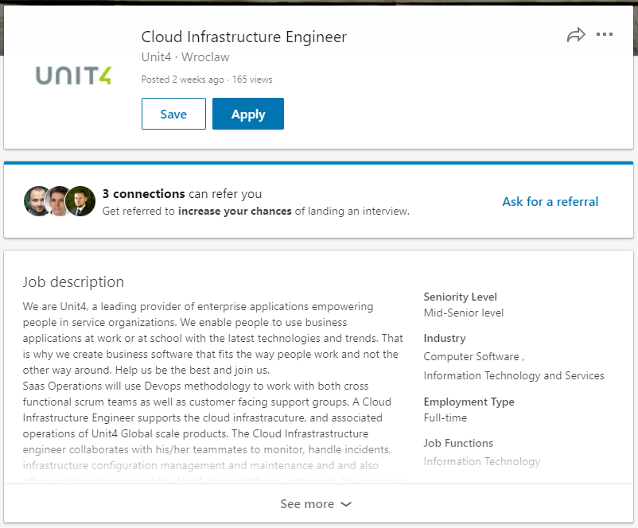
UNIT4 HR
piotr@justcloud.pl
LinkedIN
UNIT4

Slide 10






Grupy we Wro
Cloud4IT
https://www.meetup.com/Cloud4it-Group/
DevOps Wrocław
https://www.meetup.com/Wroclaw-DevOps-Meetup
PPOSH
https://www.meetup.com/Polish-PowerShell-Group-PPoSh
Wrocław .NET User Group
https://www.meetup.com/wrocnet
MAUGP
http://azureug.org
SysOps Polska
https://www.meetup.com/SysOpsPolska

Slide 11
Today
Session 1: Grupy deploy’mentowe w VSTS (Piotr Rogala)
Session 2: Chmura z punktu widzenia dewelopera (Szymon Pulka)

Slide 12
Ankieta
http://ankieta.justcloud.pl
Formularz prelegenta
http://prelegent.justcloud.pl
Prezentacje
http://maugp.justcloud.pl

Slide 13


The new style of meetups
Max 10 slides
Max 45 min
Live clicking/demo

Slide 14
Grupy deploy’mentowe w VSTS

Slide 15
VSTS?

Slide 16
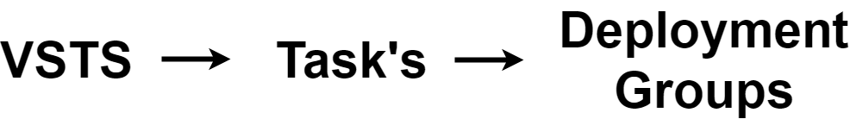

Slide 17
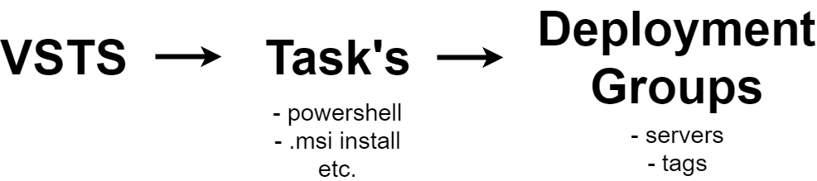

Slide 18
Deployment Groups
Security access
Agent Install
Manage servers in VSTS
Tag

Slide 19
Questions?
piotr@justcloud.pl

